Slide 1
MODULE-4
Humanization - Creative Culture – Rapid Prototyping, Strategy And Organization Business Model Desin

Slide 2
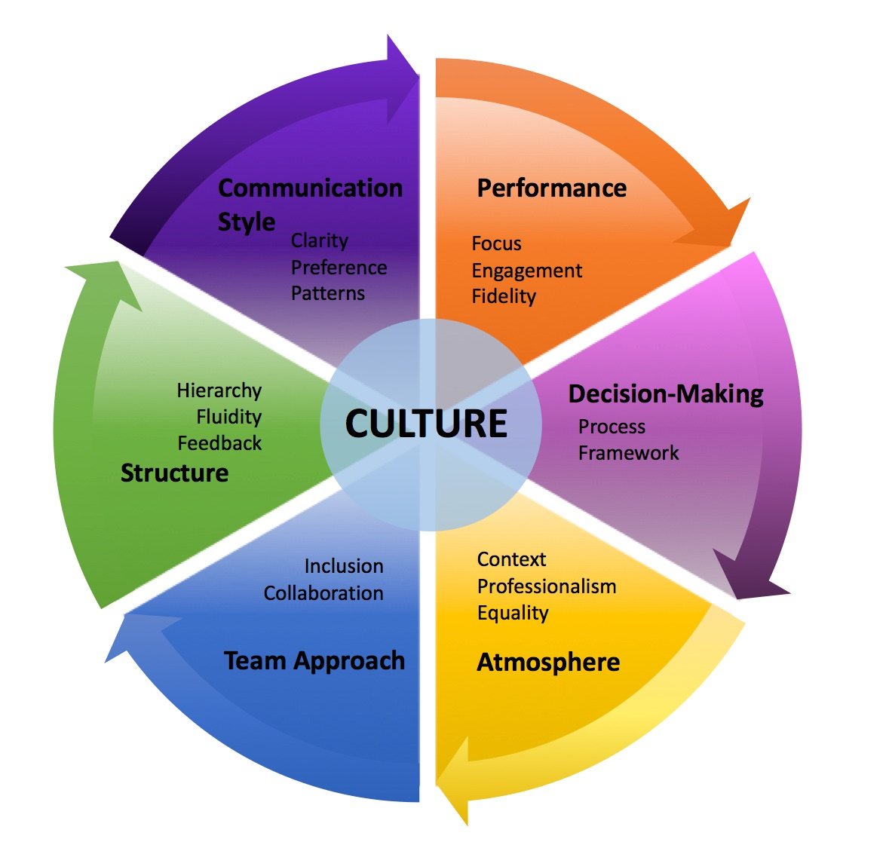
Introduction
Humanization, creative culture, rapid prototyping, strategy, and organizational business model design are essential components of modern business success.
These elements help companies adapt to changing market conditions, innovate quickly, and stay ahead of the competition.
In this presentation, we will explore how these concepts can be integrated into a cohesive business strategy.
1
Notes:
Image source: https://templates.rjuuc.edu.np/en/company-culture-template.html

Slide 3
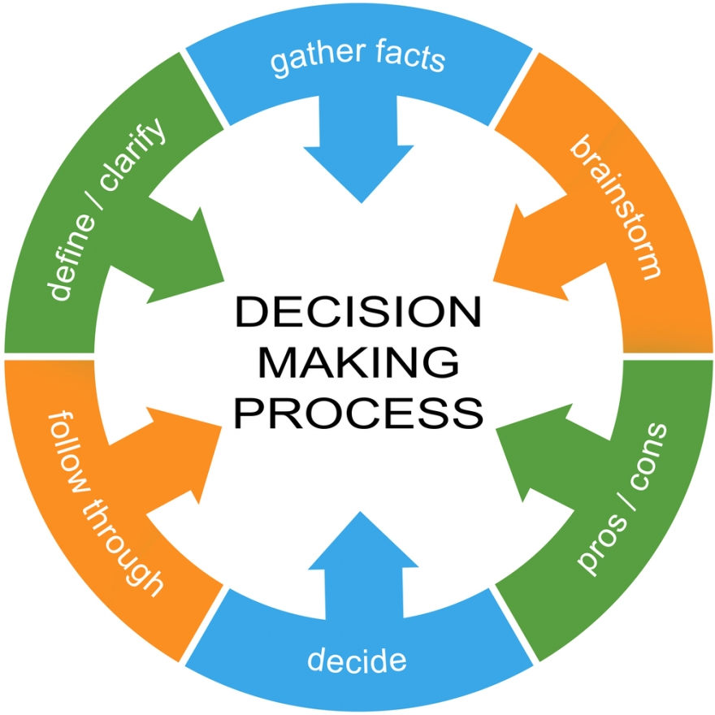
Humanization in Business
Humanization in business involves putting people at the center of decision-making processes.
By prioritizing human needs and emotions, companies can create products and services that resonate with their target audience.
This approach leads to higher customer satisfaction, loyalty, and ultimately, business success.
2
Notes:
Image source: https://mavink.com/explore/Types-of-Decision-Making-Process

Slide 4
Creative Culture
Fostering a creative culture within an organization encourages employees to think outside the box and come up with innovative solutions.
Creative teams are more likely to generate unique ideas that can disrupt the market and drive growth.
By promoting creativity and collaboration, companies can stay agile and responsive to market changes.
3
Notes:
Image source: http://www.surpassyourgoals.com/2018/05/6-elements-to-assess-your-companys-culture/

Slide 5
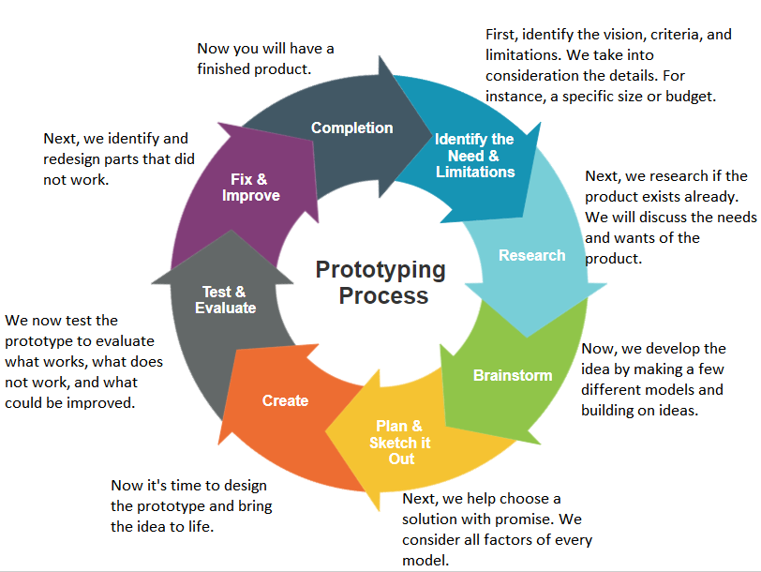
Rapid Prototyping
Rapid prototyping is a crucial step in the product development process that allows companies to quickly test ideas and gather feedback.
By iterating on prototypes, businesses can identify flaws early on and make improvements before investing heavily in production.
This approach minimizes risks and accelerates time to market, giving companies a competitive edge.
4
Notes:
Image source: https://www.teraengineering.com/prototyping-process/

Slide 6
Strategy Alignment
Aligning humanization, creative culture, and rapid prototyping with overall business strategy is key to success.
Companies must ensure that these elements are integrated into their strategic planning to achieve long-term objectives.
By aligning these components, organizations can create a cohesive approach that drives growth and innovation.
5
Notes:
Image source: https://www.linkedin.com/pulse/strategy-culture-alignment-4-steps-frank-feather-qaimeta-futurist

Slide 7
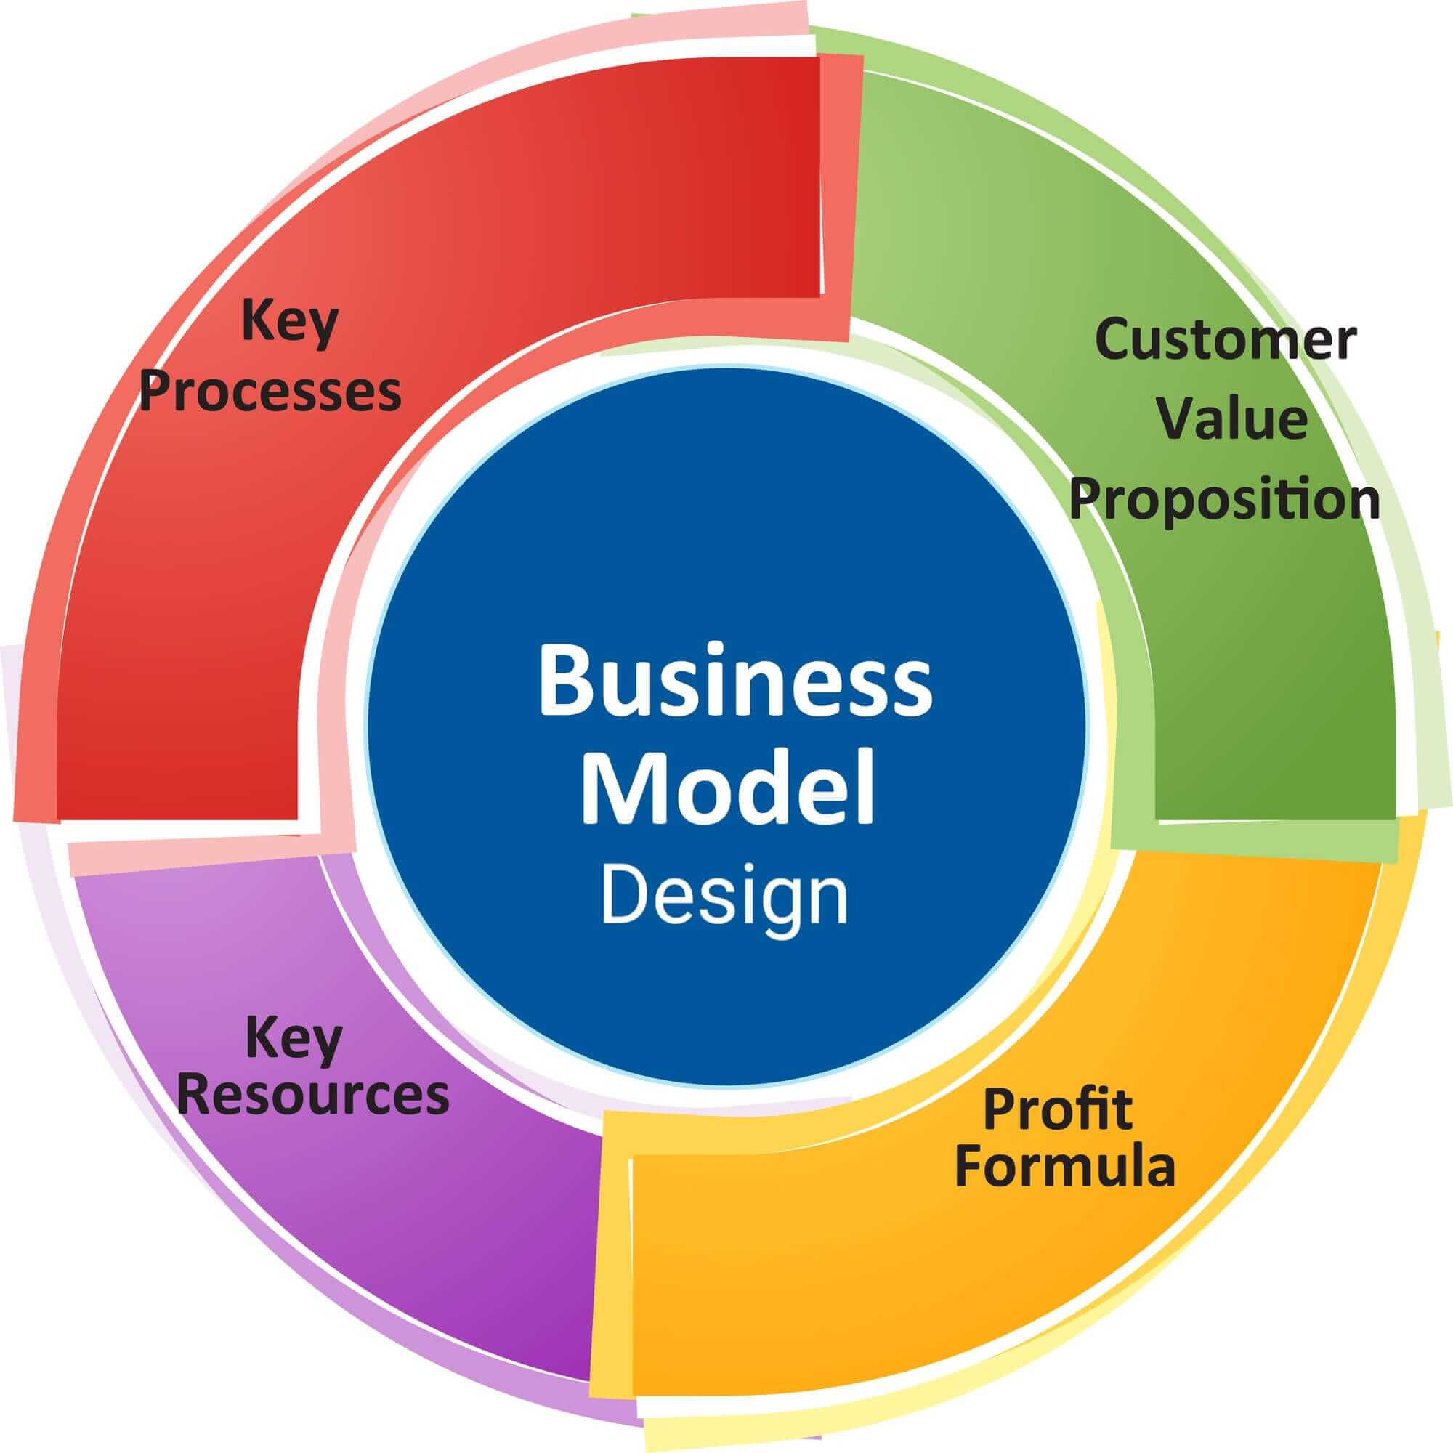
Organization Business Model Design
Designing a business model that supports humanization, creative culture, and rapid prototyping is essential for sustainable growth.
Companies must structure their organizations to enable collaboration, experimentation, and continuous improvement.
A well-designed business model allows companies to adapt to changing market conditions and seize new opportunities.
6
Notes:
Image source: https://mavink.com/explore/Business-Model-Layout

Slide 8
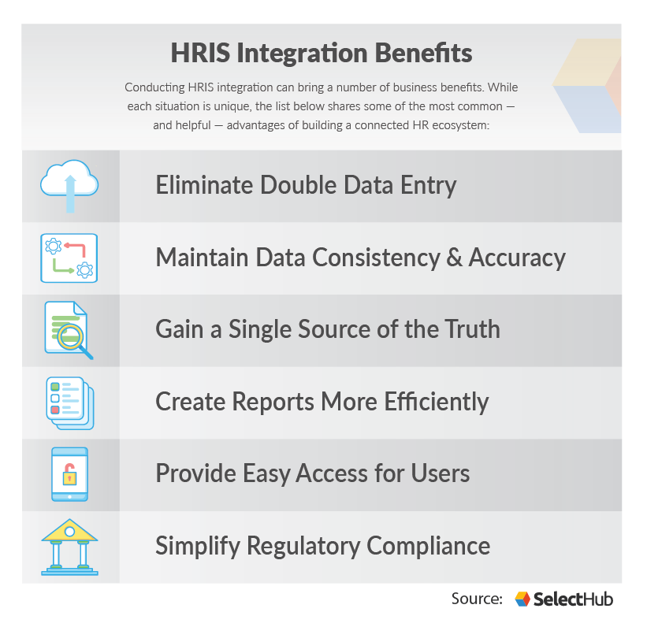
Benefits of Integration
Integrating humanization, creative culture, rapid prototyping, and strategic business model design offers numerous benefits.
Companies can better understand customer needs, innovate faster, and stay ahead of competitors.
This integrated approach leads to higher employee engagement, customer satisfaction, and overall business performance.
7
Notes:
Image source: https://www.selecthub.com/hris/hris-integration/

Slide 9
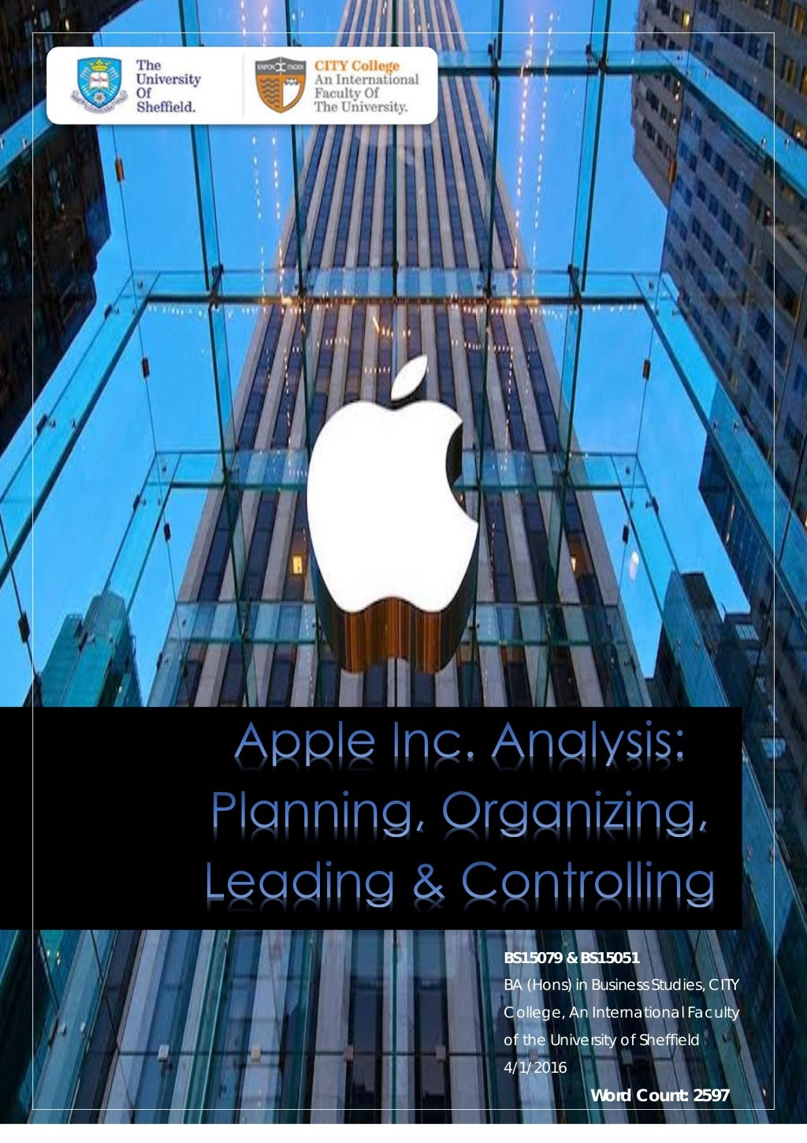
Case Study: Apple Inc.
Apple Inc. is a prime example of a company that has successfully integrated humanization, creative culture, rapid prototyping, and strategic business model design.
The company prioritizes user experience, innovation, and design in all its products and services.
By embracing these principles, Apple has become a global leader in technology and a household name.
8
Notes:
Image source: https://www.slideshare.net/SofiaDZ/case-study-apple-inc-61103768

Slide 10
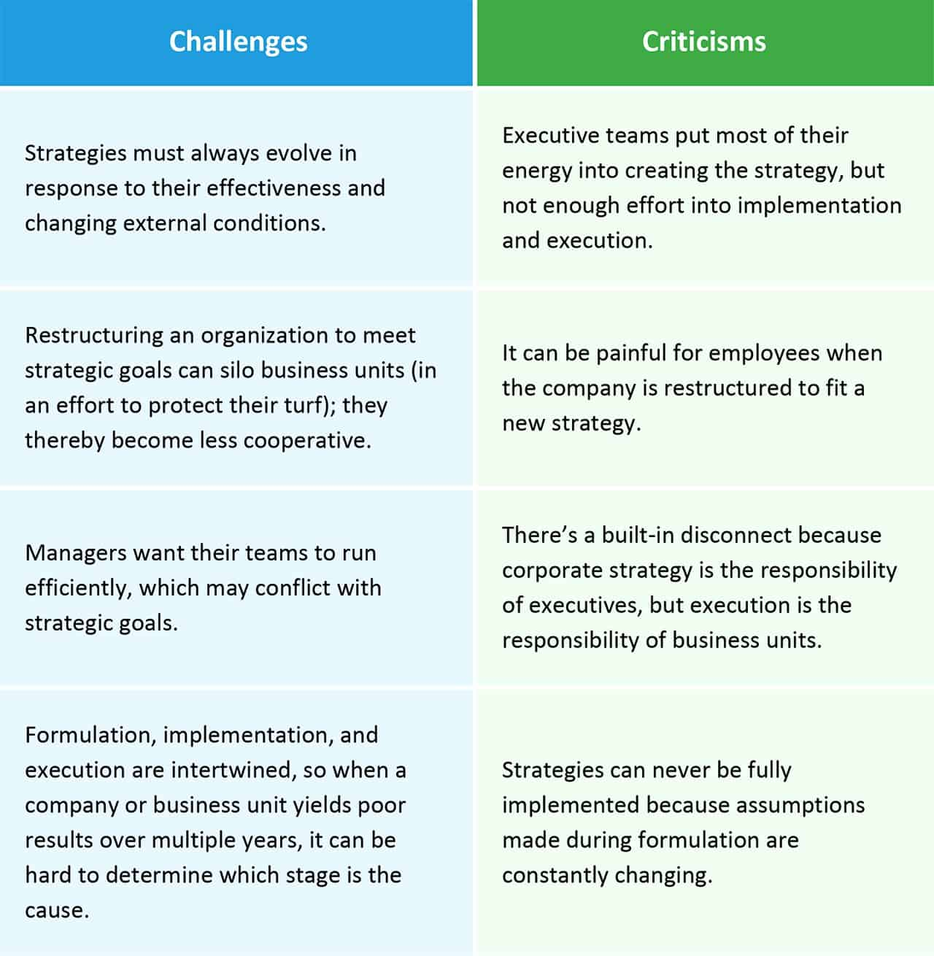
Implementation Challenges
Implementing humanization, creative culture, rapid prototyping, and strategic business model design can pose challenges for organizations.
Companies may face resistance to change, resource constraints, and internal silos that hinder progress.
Overcoming these challenges requires strong leadership, clear communication, and a commitment to continuous improvement.
9
Notes:
Image source: https://goldenrethen.blogspot.com/2022/02/managements-handling-of-strategy.html

Slide 11
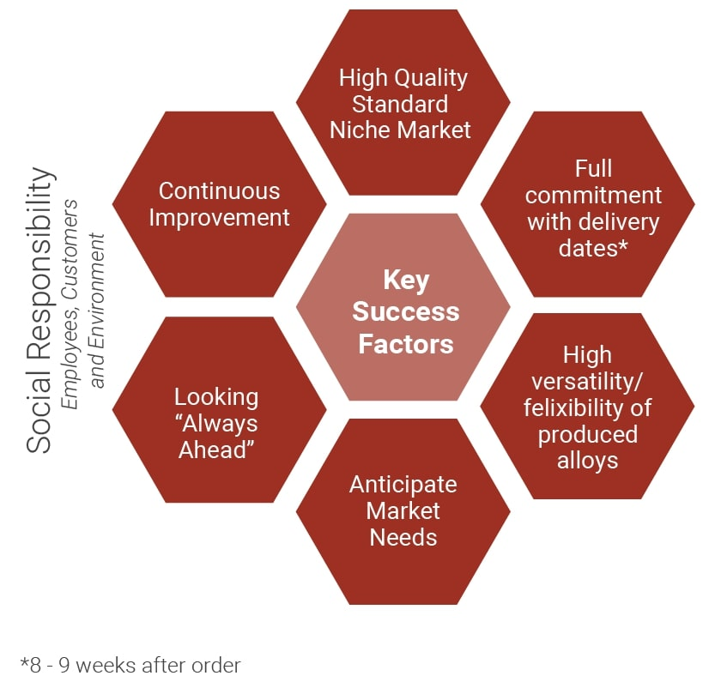
Key Success Factors
To successfully integrate humanization, creative culture, rapid prototyping, and strategic business model design, companies must focus on key success factors.
These include creating a supportive culture, investing in talent development, and leveraging technology for innovation.
By prioritizing these factors, organizations can build a foundation for sustainable growth and competitive advantage.
10
Notes:
Image source: https://blog.avada.io/resources/key-success-factors-for-business.html

Slide 12
Conclusion
Humanization, creative culture, rapid prototyping, strategy, and organizational business model design are interconnected elements that drive business success.
By integrating these concepts into a cohesive strategy, companies can adapt to changing market conditions, innovate quickly, and stay ahead of the competition.
Embracing human-centered design and fostering a culture of creativity and experimentation are essential for long-term growth and sustainability.
11
Notes:
Image source: https://medium.com/illumination/the-importance-of-organizational-culture-57d344e6a16f

Slide 13

Thank you!
Thank you for your attention.
Are there any questions?
Let's continue the conversation about humanization, creative culture, rapid prototyping, strategy, and organizational business model design.
12
Notes:
Image source: https://grammarhow.com/better-ways-to-say-thank-you-for-your-attention/

